Slide 1

Budget sales Analysis
By :- Bhawesh Sinha

Slide 2
Introduction
Ladies and gentlemen, esteemed colleagues, and stakeholders, today marks a pivotal moment as we delve into the comprehensive analysis of our sales budget data. In this presentation, we will embark on a journey to dissect the intricate layers of our sales projections, revealing insights that will not only illuminate our past performance but also pave the way for strategic decisions that will shape our future success. The sales budget serves as the bedrock of our financial planning, offering a roadmap that guides our actions and aspirations. Through meticulous examination and thoughtful interpretation, we aim to uncover trends, identify opportunities, and address challenges that lie ahead. Our collective understanding of this data will empower us to optimize resource allocation, enhance operational efficiency, and ultimately drive sustainable growth. So, let us embark on this journey together, armed with data-driven insights that will propel us towards our organizational objectives.

Slide 3
Details about the Data.
From Customer’s Data:
Customer Key – The unique number assigned to the customers
First Name – Their First name
Last Name – Their Last name
Full Name – First name + Last Name
Birth Date – Their Date of Birth(YYYY/MM/DD)
Marital Status – If they are Single or Married (S/M)
Gender – Their Gender(Male/Female)

Slide 4
8. Yearly Income – How much Money they earn per annum
9. Total Children – Number of Children they have
10. Number of Children at Home – Number of Children stays at Home
Education – Their Educational qualification
Occupation – Their Profession based on experience
House Flag – They own a house or not(0/1)
Number of Cars Owned – Total number of card they have.
Address Line 1 – Their Address
Date First Purchase – The first date on which they purchased
Commute Distance – Distance between their residence and shop

Slide 5
From Product’s Data:
Product Key – Unique Product identity
Product name – Name of the sold product
Sub Category – Lower Hierarchy of Category
Category – Category or group of which the product belongs to
Standard Cost – Their manufacturer cost
Color – Color of Product
List Price – Selling pricing
Days To Manufacture – Number of days taken to manufacture the product

Slide 6
From Sale’s Data:
Product Key – The unique product identity
Order date – Date of Order of product
Ship date – Date of Dispatchment
Customer key – Unique customer identity
Promotion key – Unique promotion ranking
Sales Territory Key – Unique identity of Sales territory
Sales order number – Unique number assigned to the order
Sales order line number – Line of Order
Order quantity – Number of units orders
Unit Price – Price of one unit of product
Standard Cost – Manufacture cost
12. List price – Selling price

Slide 7
Main KPIs
Customer’s Marital Status
Customer’s Gender
Customer’s Yearly income
Total Children they have and total children stays at home
Their educational qualification
Their Profession
Their House ownership status
Their Car Ownership status
Category ,Sub-Category and Name of Product

Slide 8
Cost of Manufacturing the product
Color of Product
Selling price of Product
Days Taken to Manufacture
Date of order of product
Date of Shipment of Product
Units of Product Order
Units price and selling price

Slide 9
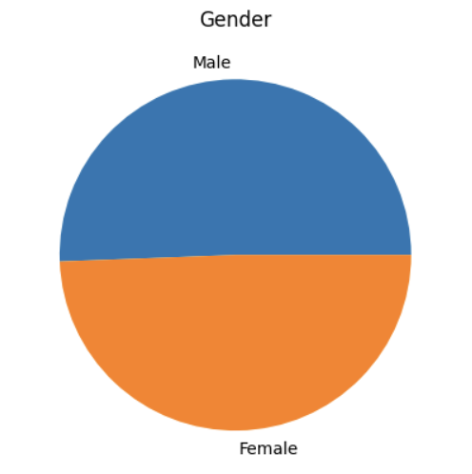
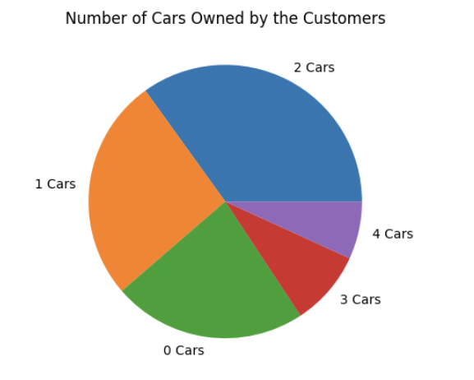
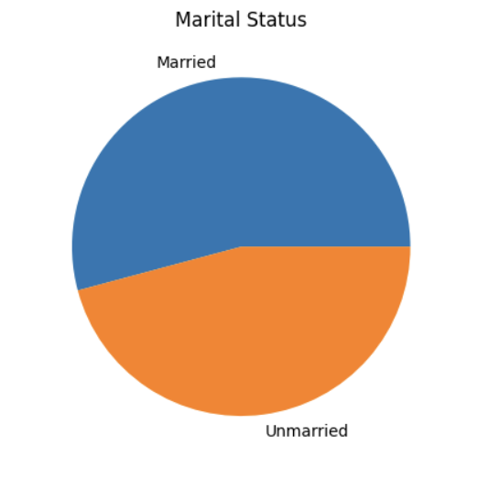
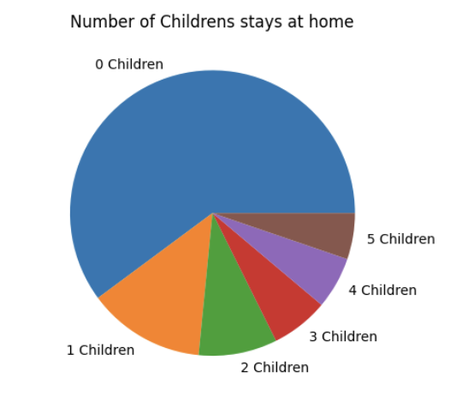
Mockup Dashboard
Approximately 50% of the customers are Male and 50% are Female.
Majority of them owns 2 cars.
More than 50% of them are Married.
Majority of them have no child stays at home.

Slide 10
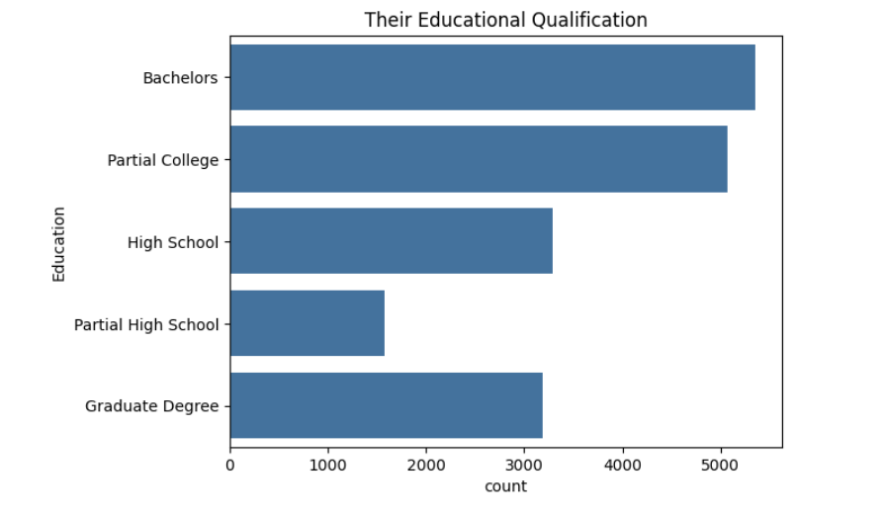
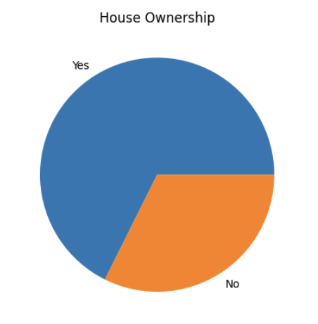
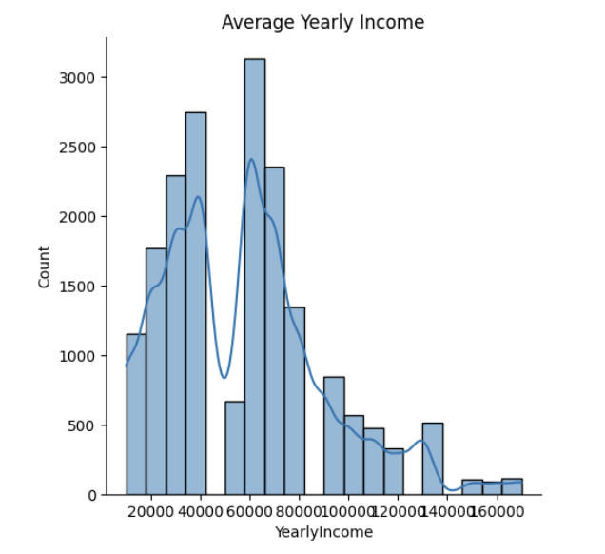
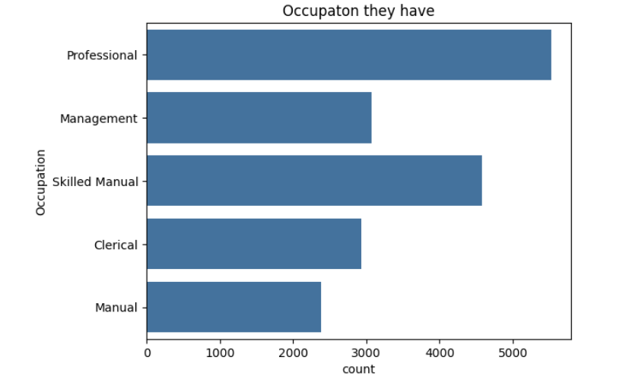
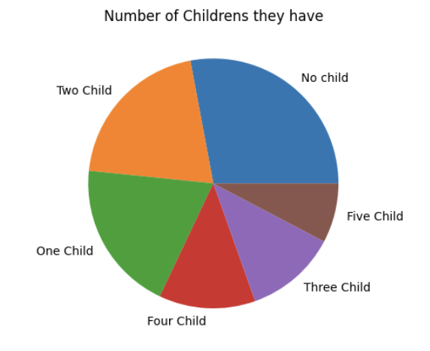
Maximum of the customers are bachelor in qualification
Majority of them have their own house.
On an average their salary falls between 60K to 80K
Majority of them are professional
Majority of them do not have child and few of them have five child.

Slide 11
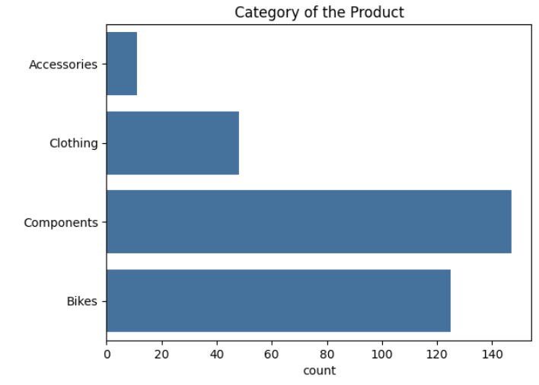
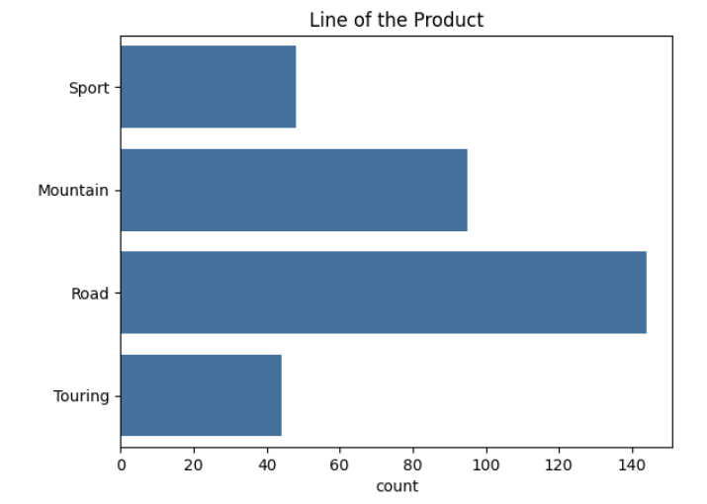
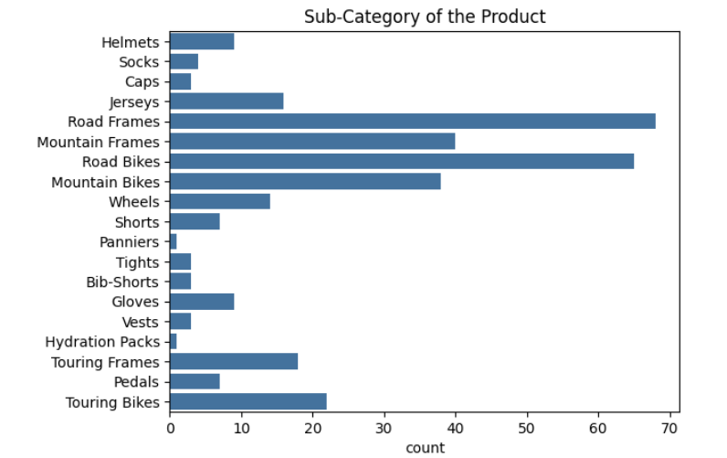
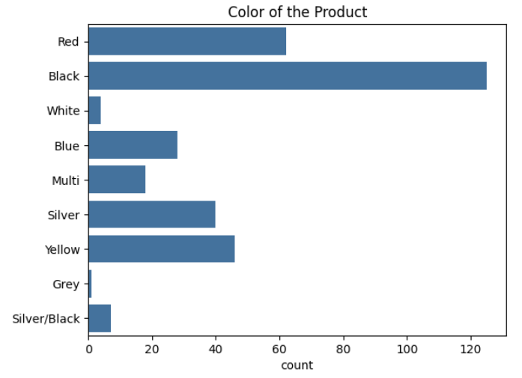
Majority of them are related to Road line.
Most Sales were of Components.
Most of them were road frames.
Most sold color is Black in all of them.

Slide 12
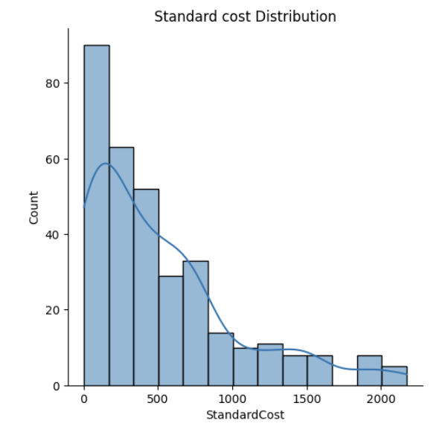
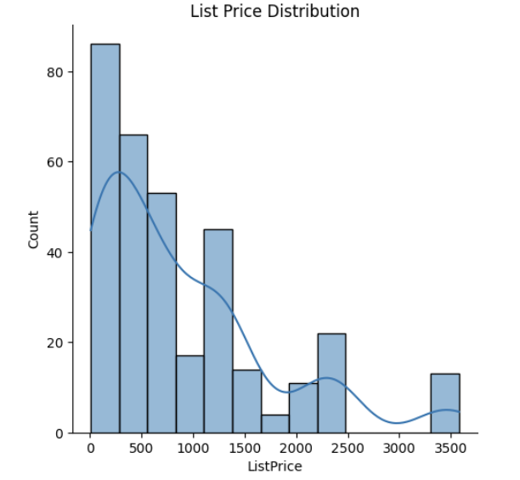
On an average the standard cost is from 0 to 500.
On an average the List cost is from 0 to 550.

Slide 13
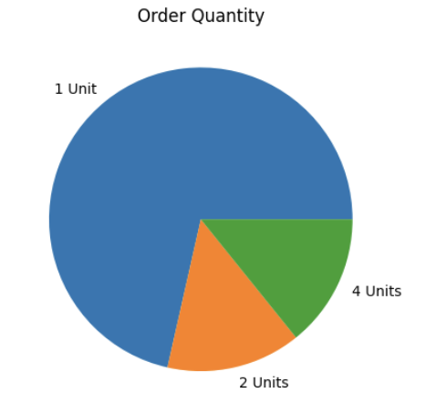
Majority of the customers orders only 1 unit of the product overall.

Slide 14
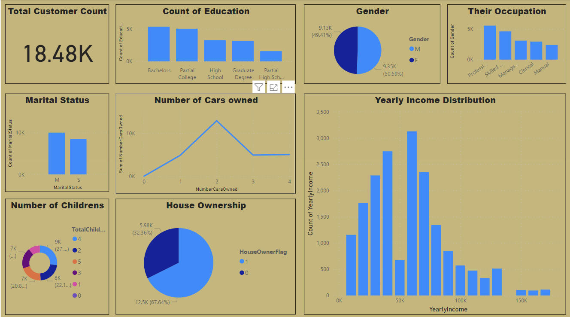
My Design
Customers Dashboard

Slide 15
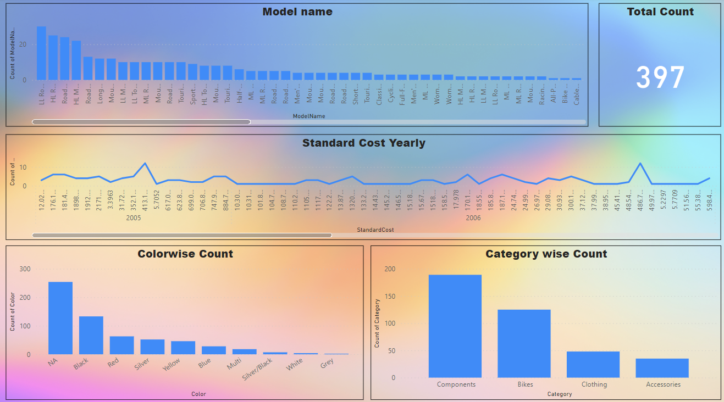
Product Dashboard

Slide 16
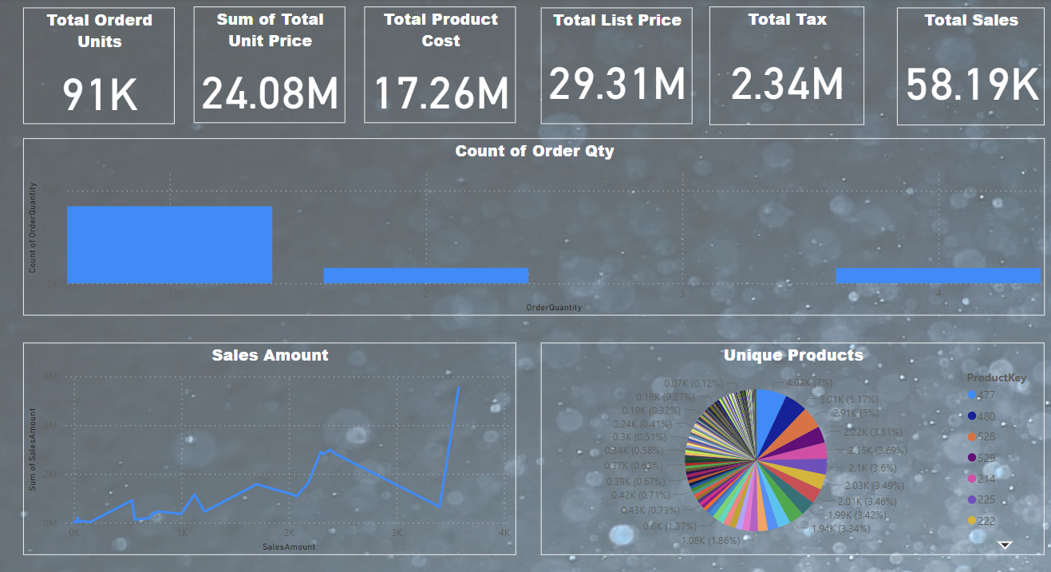
Sales Dashboard

Slide 17
Thank you

